Slide 1
Automated Identification of Potholes Using Remotely Sensed Data
Meghan Kulkarni

Slide 2
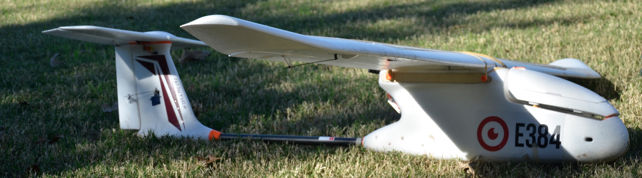
Introduction
Transportation infrastructure is a key element driving economic growth in developing countries. World-class expressways and highways make transportation efficient. However over time this infrastructure requires maintenance. Potholes or cracks cause safety hazards and present dangerous conditions for motorists. UAV technology can be utilized to remotely capture real time road condition data. This project aims to investigate digital processing alternatives for feature identification.

Slide 3
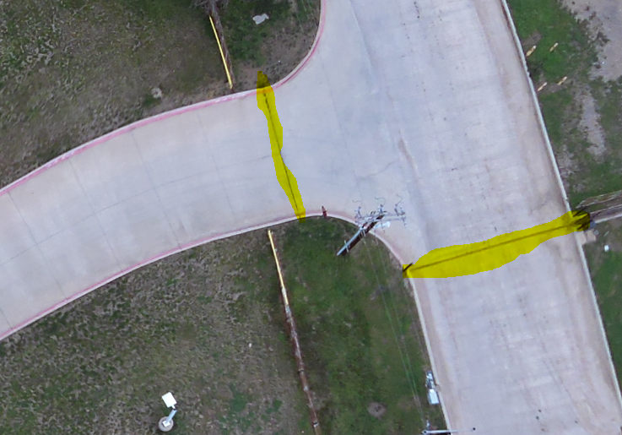
Purpose
Evaluate automated identification of roadway damage to increase efficiency of UAV employment using nearest neighbor algorithm to distinguish target features.

Slide 4
Rationale
Methods must be developed to coordinate UAV flight paths pre-programmed with GPS routes according to roadway infrastructure. This aspect poses no particular issues given the reliability of conventional route programming with GPS enabled UAV units.
This proposal utilizes static images as an alternative methodology to live video for the purpose of increasing automated efficiency. In other words, this proposal intends to eliminate the need for active monitoring by a UAV pilot.

Slide 5
Background
Potholes present transportation challenges often requiring constant need for repair and maintenance. Proliferation of UAV technology across a variety of applications has emerged as an economical and robust platform with which to increase roadway maintenance efficiency as well as public safety.
The present challenge concerns reliable automated identification of distressed areas of roadway infrastructure. In methods proposed by Lokeshwor Huidrom, et.al:
“pothole, cracks and patches from real life video clips of highways are detected and quantified automatically using various image processing techniques supported by heuristically derived decision logic.”

Slide 6
Hypothesis
Digital still frame images in the visual spectrum captured with UAV’s can be processed using the Nearest Neighbor (8 pixel) formula to distinguish between pixel values for the purpose of identifying particular features – in this case areas of roadway in need of maintenance or repair.

Slide 7
Methodology
Image Acquisition
Statistical Modeling
Acquire digital image of target feature – in this case Google Earth imagery
Convert radiance data band (BGR) values to digital number format (DN)
Process data in Python script via OpenCV library
Generate histogram by plotting BGR DN values
Analyze histogram for max/min DN values
Compare/contrast multiple digital image samples

Slide 8
Methodology – Image Acquisition
Study area geographically
delimited to municipal
roadway in McKinnish Park,
Carrollton, TX.

Slide 9
Methodology – Image Acquisition

Slide 10
Methodology – Coding & Analysis

Slide 11
Methodology – Coding & Analysis

Slide 12
Limitations/Delimitations
Limitations
Employment of reliable UAV platform for adequate digital image acquisition is assumed, but not employed due to availability.
Delimitations
Data corresponds to municipal roadway in McKinnish Park, Carrollton, TX.
Limiting study to concrete (high reflectance) roads, pavement/asphalt roadways not included for preliminary findings.

Slide 13
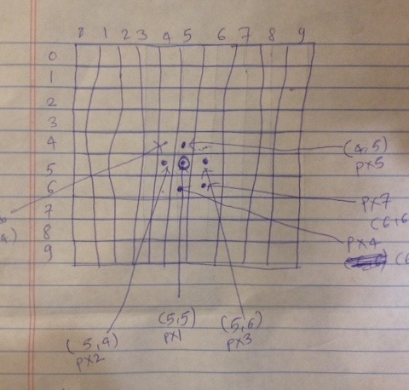
Definitions (Key Terms)
Nearest Neighbor (8 pixel) Formula
Nearest neighbor interpolation is the simplest approach to interpolation. Rather than calculate an average value by some weighting criteria or generate an intermediate value based on complex rules, this method simply determines the “nearest” neighboring pixel, and assumes the intensity value of it.

Slide 14
Tools
OpenCV (Open Source Image Processing Library)
Python - NumPy Library (a part of SciPy Toolkit)
Google Earth for input images

Slide 15
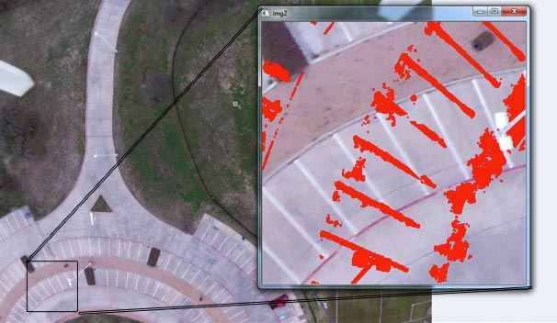
Preliminary Results

Slide 16
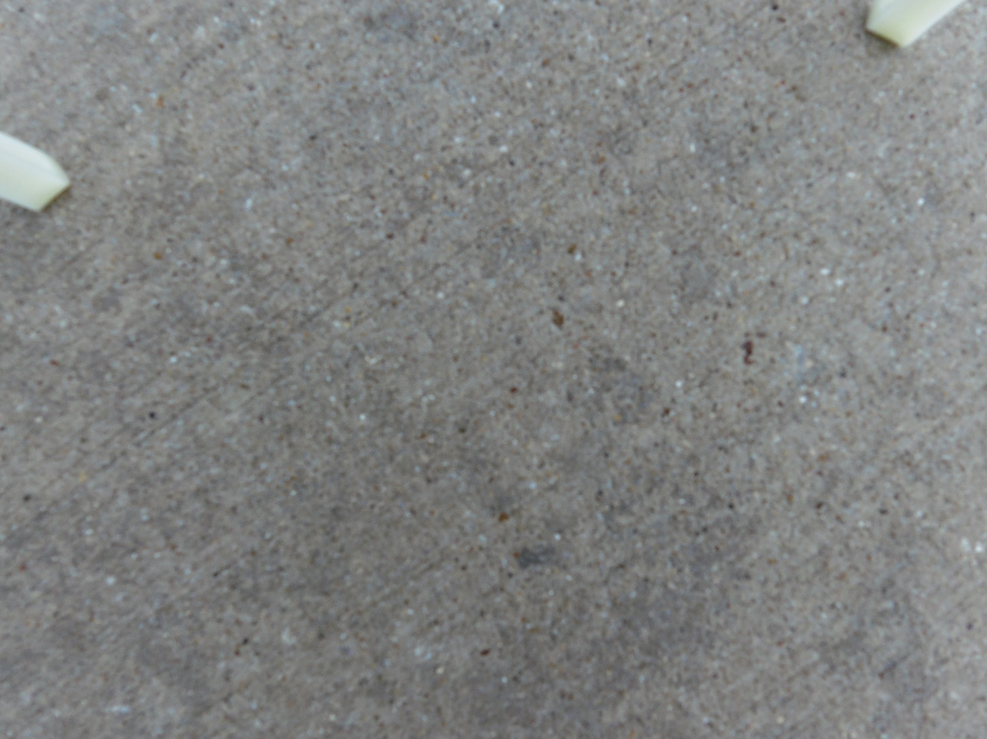
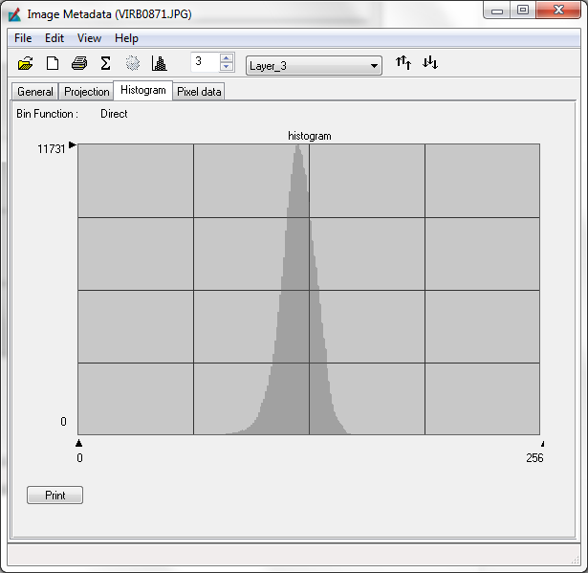
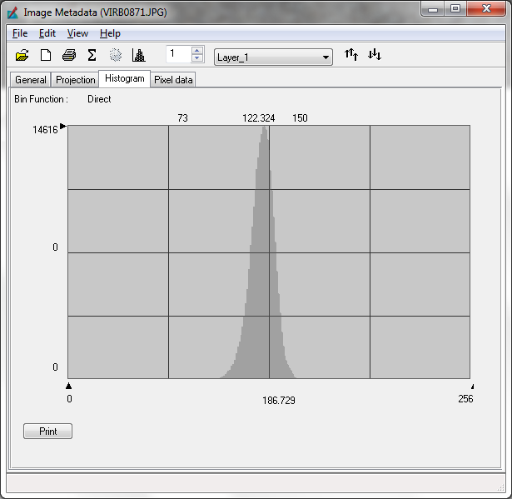
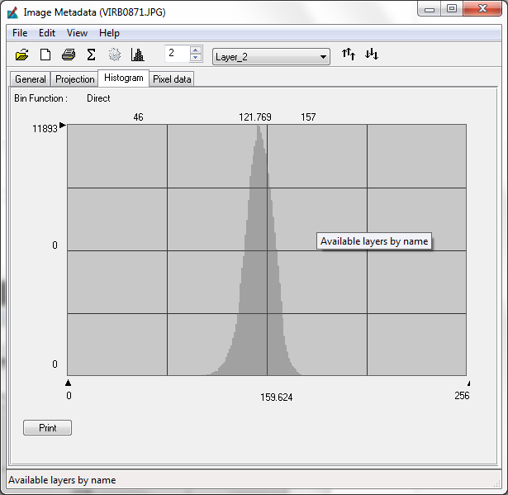
Preliminary analytical results render homogenous target features relatively indistinguishable in all three bands (RGB).
Image Data File VIRB0871.JPG
Band 1 (Blue) Histogram
Band 2 (Green) Histogram
Band 3 (Red) Histogram

Slide 17
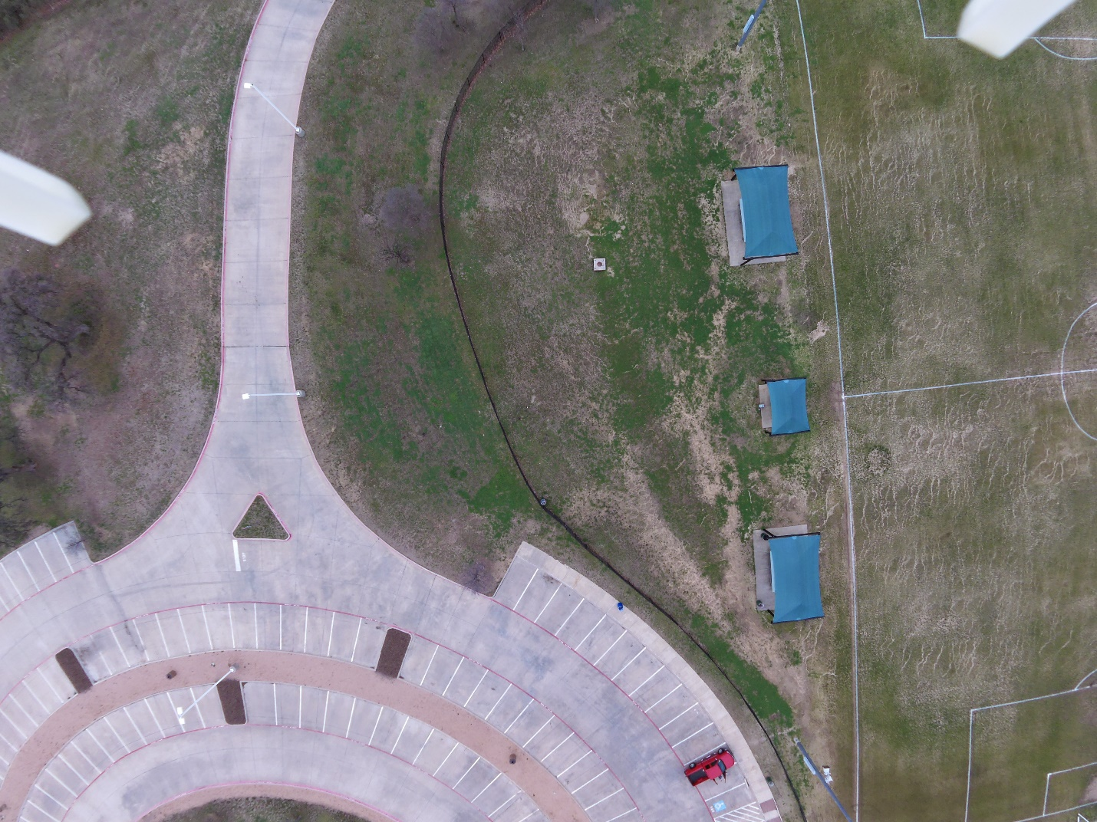
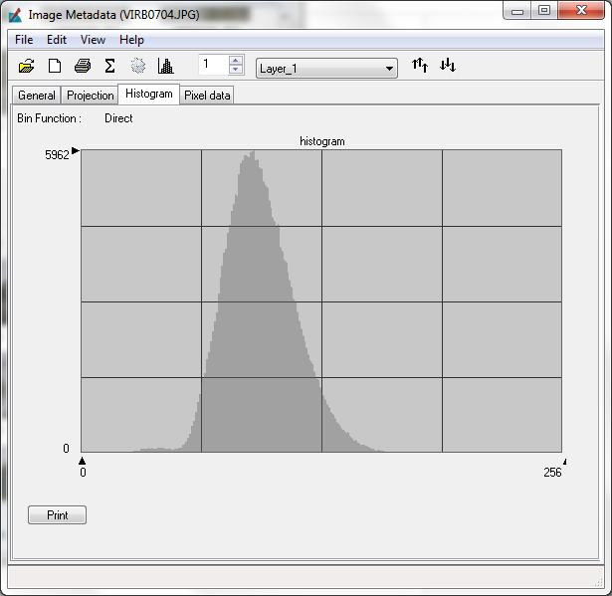
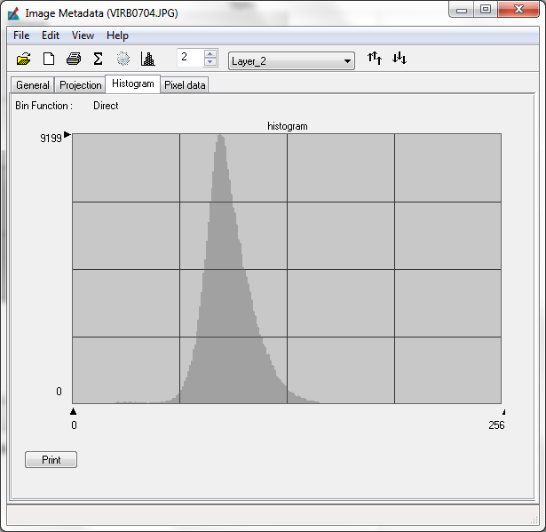
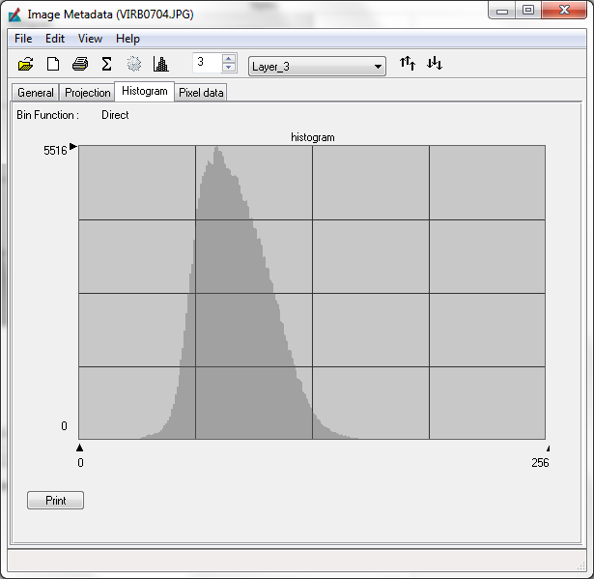
Whereas, procedures applied to contrasting pixel sets exhibit differing histogram widths according to Digital Number. Simply stated, our analytical procedure identifies target based on bands.
Image Data File VIRB0704.JPG
Band 1 (Blue) Histogram
Band 2 (Green) Histogram
Band 3 (Red) Histogram

Slide 18
References
References:
1. L Huidrom et. al, “Method for automated assessment of potholes, cracks and patches from road surface video clips”, 2nd Conference of Transportation Research Group of India
2. OpenCV with Python for Image and Video Analysis
https://www.youtube.com/watch?v=Z78zbnLlPUA&list=PLQVvvaa0QuDdttJXlLtAJxJetJcqmqlQq
3. UAV Data provided by Dr. Anthony Cummings

